Slide 1

School of Computing Science and Engineering
Course Code : R1UC604C Course Name: Deep Learning
Machine Learning Briefs
Name of the Faculty: Dr. Abdul Aleem Program Name: B.Tech CSE

Slide 2
School of Computing Science and Engineering
Course Code : R1UC604C Course Name: Deep Learning
Machine Learning (ML)
The term ML was coined by Arthur Samuel in 1959.
ML is the science of making computers learn and act like humans by feeding data and information without being explicitly programmed.
ML is the is a core sub-area of Artificial Intelligence (AI).
ML applications learn from experience like humans without direct programming.
Machine learning algorithms are trained with training data. When new data comes in, they can make predictions and decisions accurately based on past data.
Name of the Faculty: Dr. Abdul Aleem Program Name: B.Tech CSE

Slide 3
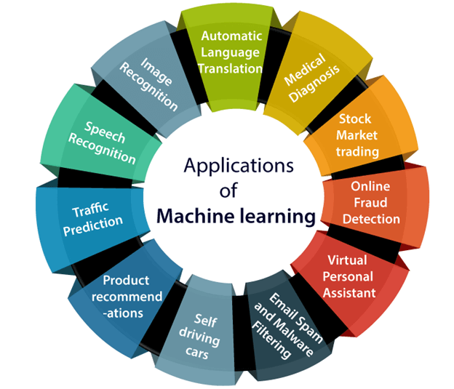
School of Computing Science and Engineering
Course Code : R1UC604C Course Name: Deep Learning
Name of the Faculty: Dr. Abdul Aleem Program Name: B.Tech CSE

Slide 4
School of Computing Science and Engineering
Course Code : R1UC604C Course Name: Deep Learning
1. Image Recognition
It is used to identify objects, persons, places, digital images, etc.
The popular use case of image recognition and face detection is, Automatic friend tagging suggestion:
Facebook provides us a feature of auto friend tagging suggestion.
Whenever we upload a photo with our Facebook friends, then we automatically get a tagging suggestion with name, and the technology behind this is machine learning's face detection and recognition algorithm.
It is based on the Facebook project named "Deep Face," which is responsible for face recognition and person identification in the picture.
Name of the Faculty: Dr. Abdul Aleem Program Name: B.Tech CSE

Slide 5
School of Computing Science and Engineering
Course Code : R1UC604C Course Name: Deep Learning
2. Speech Recognition
While using Google, we get an option of "Search by voice," it comes under speech recognition, and it's a popular application of machine learning.
Speech recognition is a process of converting voice instructions into text, and it is also known as "Speech to text", or "Computer speech recognition."
Google assistant, Siri, Cortana, and Alexa are using speech recognition technology to follow the voice instructions.
Name of the Faculty: Dr. Abdul Aleem Program Name: B.Tech CSE

Slide 6
School of Computing Science and Engineering
Course Code : R1UC604C Course Name: Deep Learning
3. Product Recommendations
Machine learning is widely used by various e-commerce and entertainment companies such as Amazon, Netflix, etc., for product recommendation to the user.
Whenever we search for some product on Amazon, then we started getting an advertisement for the same product while internet surfing on the same browser and this is because of machine learning.
Google understands the user interest using various ML algorithms and suggests the product as per customer interest.
As similar, when we use Netflix, we find some recommendations for entertainment series, movies, etc., and this is also done with the help of machine learning.
Name of the Faculty: Dr. Abdul Aleem Program Name: B.Tech CSE

Slide 7
School of Computing Science and Engineering
Course Code : R1UC604C Course Name: Deep Learning
4. Self-driving cars
One of the most exciting applications of machine learning is self-driving cars.
ML plays a significant role in self-driving cars.
Tesla, the most popular car manufacturing company is working on self-driving car.
Name of the Faculty: Dr. Abdul Aleem Program Name: B.Tech CSE

Slide 8
School of Computing Science and Engineering
Course Code : R1UC604C Course Name: Deep Learning
5. Email Spam and Malware Filtering
Whenever we receive a new email, it is filtered automatically as important, normal, and spam.
We always receive an important mail in our inbox with the important symbol and spam emails in our spam box, and the technology behind this is Machine learning.
Name of the Faculty: Dr. Abdul Aleem Program Name: B.Tech CSE

Slide 9
School of Computing Science and Engineering
Course Code : R1UC604C Course Name: Deep Learning
6. Virtual Personal Assistant
We have various virtual personal assistants such as Google assistant, Alexa, Cortana, Siri. As the name suggests, they help us in finding the information using our voice instruction.
These assistants can help us in various ways just by our voice instructions such as Play music, call someone, Open an email, Scheduling an appointment, etc.
These are prominent applications but countless applications exists which could be discovered in day-to-day life.
Name of the Faculty: Dr. Abdul Aleem Program Name: B.Tech CSE

Slide 10
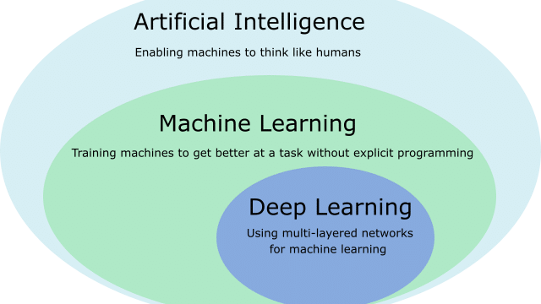
School of Computing Science and Engineering
Course Code : R1UC604C Course Name: Deep Learning
Name of the Faculty: Dr. Abdul Aleem Program Name: B.Tech CSE

Slide 11
School of Computing Science and Engineering
Course Code : R1UC604C Course Name: Deep Learning
Comparing AI and ML
Artificial Intelligence | Machine learning
Artificial intelligence is a technology which enables a machine to simulate human behavior. | Machine learning is a subset of AI which allows a machine to automatically learn from past data without programming explicitly.
The goal of AI is to make a smart computer system like humans to solve complex problems. | The goal of ML is to allow machines to learn from data so that they can give accurate output.
Machine learning and deep learning are the two main subsets of AI. | Deep learning is a main subset of machine learning.
AI has a very wide range of scope. | ML has a limited scope.
AI system is concerned about maximizing the chances of success. | Machine learning is mainly concerned about accuracy and patterns.
The main applications of AI are Siri, customer support using chatboats, Expert System, Online game playing, intelligent humanoid robot, etc. | The main applications of machine learning are Online recommender system, Google search algorithms, Facebook auto friend tagging suggestions, etc.
On the basis of capabilities, AI can be divided into three types, which are, Weak AI, General AI, and Strong AI. | Machine learning can also be divided into mainly three types that are Supervised learning, Unsupervised learning, and Reinforcement learning.
Name of the Faculty: Dr. Abdul Aleem Program Name: B.Tech CSE

Slide 12
School of Computing Science and Engineering
Course Code : R1UC604C Course Name: Deep Learning
Dataset
A dataset is a collection of data in which data is arranged in some order.
A dataset can contain any data from a series of an array to a database table. Below table shows an example of the dataset:
Country | Age | Salary | Purchased
India | 38 | 48000 | No
France | 43 | 45000 | Yes
Germany | 30 | 54000 | No
France | 48 | 65000 | No
Germany | 40 | 74000 | Yes
India | 35 | 58000 | Yes
Name of the Faculty: Dr. Abdul Aleem Program Name: B.Tech CSE

Slide 13
School of Computing Science and Engineering
Course Code : R1UC604C Course Name: Deep Learning
Iris Dataset
S.No. | Sepal Length | Sepal Width | Petal Length | Petal Width | Class
1 | 5.1 | 3.5 | 1.4 | 0.2 | Iris-setosa
2 | 4.9 | 3.0 | 1.4 | 0.2 | Iris-setosa
. 50 | . . |  |  |  | Iris Setosa
51 | 6.3 | 2.5 | 4.9 | 1.5 | Iris-versicolor
52 | 6.1 | 2.8 | 4.7 | 1.2 | Iris-versicolor
. 100 |  |  |  |  | Iris-versicolor
101 | 6.4 | 3.1 | 5.5 | 1.8 | Iris-virginica
. 150 |  |  |  |  | Iris-virginica
Features:- Sepal Length, Sepal Width, Petal Length, Petal Width
Classes- Iris-setosa, Iris-versicolor, Iris-virginica
Name of the Faculty: Dr. Abdul Aleem Program Name: B.Tech CSE

Slide 14
School of Computing Science and Engineering
Course Code : R1UC604C Course Name: Deep Learning
Popular sources for ML datasets
S.No. | Name | Link
1 | Kaggle Datasets | https://www.kaggle.com/datasets
2 | UCI Machine Learning Repository | https://archive.ics.uci.edu/ml/index.php
3 | Datasets via AWS | https://registry.opendata.aws/
4 | Google's Dataset Search Engine | https://toolbox.google.com/datasetsearch
5 | Microsoft Datasets | https://msropendata.com/
6 | Awesome Public Dataset Collection | https://github.com/awesomedata/awesome-public-datasets
7 | Government Datasets
8 | Computer Vision Datasets | https://www.visualdata.io/
9 | Scikit-learn dataset | https://scikit-learn.org/stable/datasets/index.html
Name of the Faculty: Dr. Abdul Aleem Program Name: B.Tech CSE

Slide 15
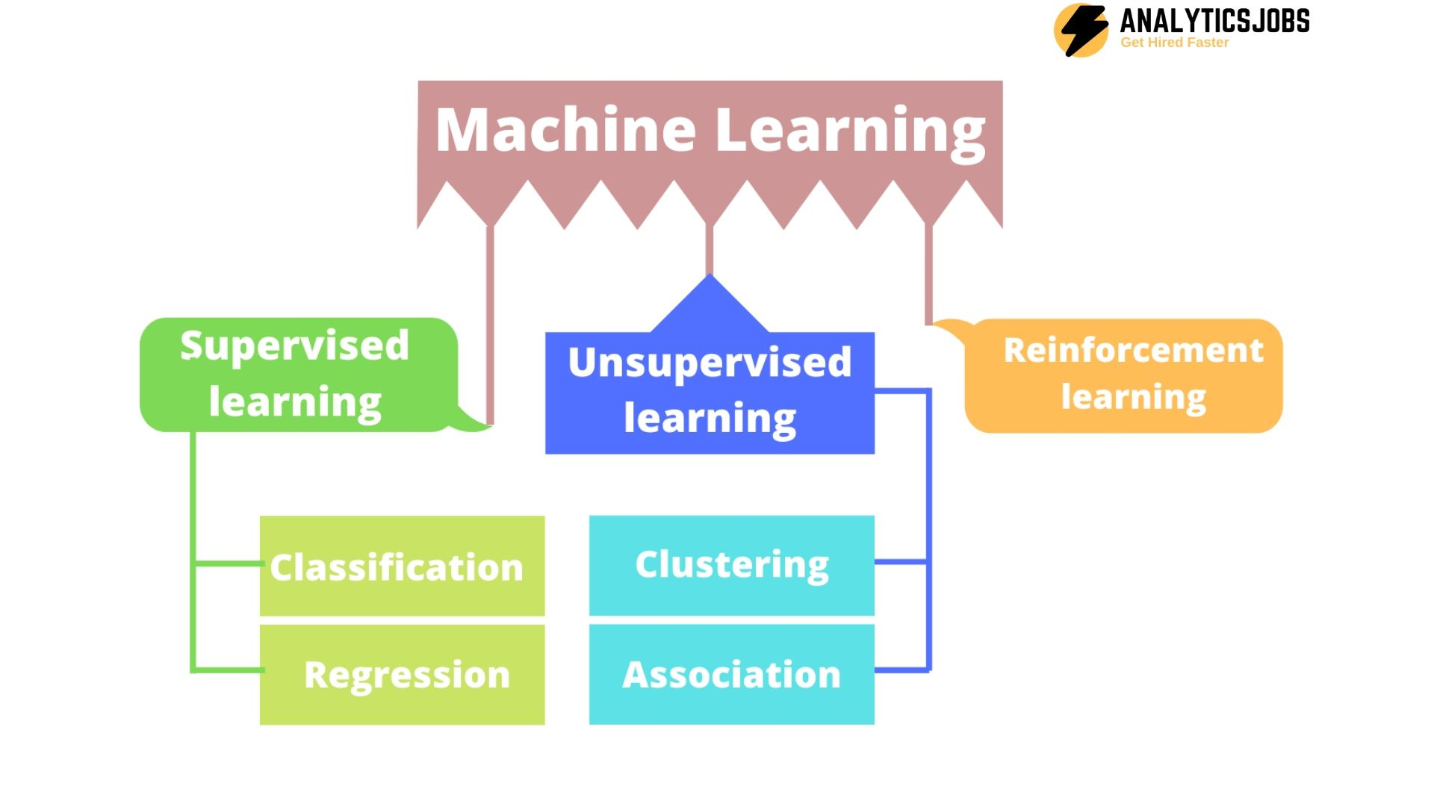
School of Computing Science and Engineering
Course Code : R1UC604C Course Name: Deep Learning
Types of Machine Learning
Source: https://analyticsjobs.in/education/types-of-machine-learning/
Name of the Faculty: Dr. Abdul Aleem Program Name: B.Tech CSE

Slide 16
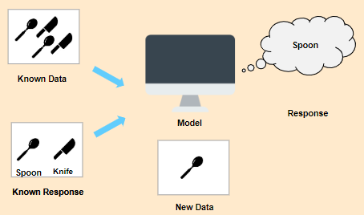
School of Computing Science and Engineering
Course Code : R1UC604C Course Name: Deep Learning
Supervised Learning
In Supervised Learning, the machine learns under supervision.
It contains a model that is able to predict with the help of labelled dataset.
A labelled dataset is one where you already know the target answer.
Name of the Faculty: Dr. Abdul Aleem Program Name: B.Tech CSE

Slide 17
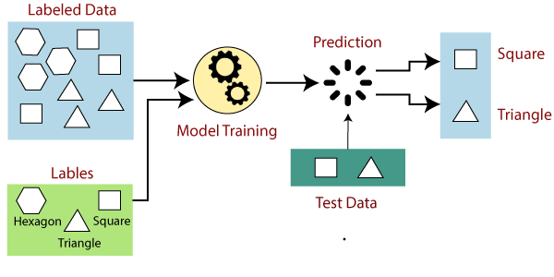
School of Computing Science and Engineering
Course Code : R1UC604C Course Name: Deep Learning
Supervised Learning Example
Name of the Faculty: Dr. Abdul Aleem Program Name: B.Tech CSE

Slide 18
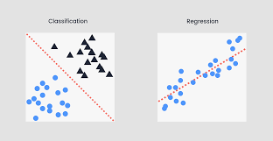
School of Computing Science and Engineering
Course Code : R1UC604C Course Name: Deep Learning
Supervised Learning Types
Supervised learning can be further divided into two types:
Classification
Regression
Name of the Faculty: Dr. Abdul Aleem Program Name: B.Tech CSE

Slide 19
School of Computing Science and Engineering
Course Code : R1UC604C Course Name: Deep Learning
Classification
Classification is used when the output variable is categorical i.e. with 2 or more classes.
For example, yes or no, male or female, true or false, etc.
Mail spam classification discussed on next slide.
Name of the Faculty: Dr. Abdul Aleem Program Name: B.Tech CSE

Slide 20
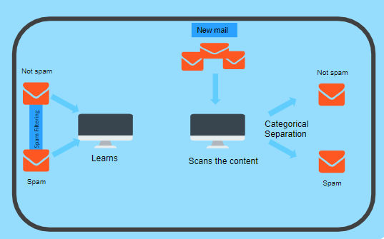
School of Computing Science and Engineering
Course Code : R1UC604C Course Name: Deep Learning
In order to predict whether a mail is spam or not, we need to first teach the machine what a spam mail is.
This is done based on a lot of spam filters - reviewing the content of the mail, reviewing the mail header and then searching if it contains any false information. Certain keywords and blacklist filters that are used from already blacklisted spammers.
All of these features are used to score the mail and give it a spam score. The lower the total spam score of the email, the more likely that it is not a scam.
Based on the content, label and the spam score of the new incoming mail, the algorithm decides whether it should land in the inbox or spam folder.
Name of the Faculty: Dr. Abdul Aleem Program Name: B.Tech CSE

Slide 21
School of Computing Science and Engineering
Course Code : R1UC604C Course Name: Deep Learning
Classification Algorithms
Guasian Naïve Bayes
Support Vector Machine
Decision Trees
Random Forest
K-Nearest Neighbor
…
Name of the Faculty: Dr. Abdul Aleem Program Name: B.Tech CSE

Slide 22
School of Computing Science and Engineering
Course Code : R1UC604C Course Name: Deep Learning
Regression
Regression algorithms are used if there is a relationship between the input variable and the output variable, i.e. a change in one variable is associated with a change in the other variable.
For example, salary based on work experience or weight based on height, etc.
Regression for temperature and humidity is shown on next slide.
Name of the Faculty: Dr. Abdul Aleem Program Name: B.Tech CSE

Slide 23
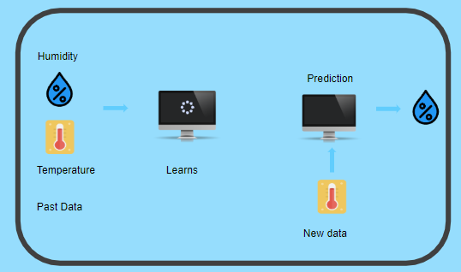
School of Computing Science and Engineering
Course Code : R1UC604C Course Name: Deep Learning
Let’s consider two variables - humidity and temperature.
Here, ‘temperature’ is the independent variable and ‘humidity' is the dependent variable.
If the temperature increases, then the humidity decreases.
These two variables are fed to the model and the machine learns the relationship between them.
After the machine is trained, it can easily predict the humidity based on the given temperature.
Name of the Faculty: Dr. Abdul Aleem Program Name: B.Tech CSE

Slide 24
School of Computing Science and Engineering
Course Code : R1UC604C Course Name: Deep Learning
Regression Algorithms
Linear Regression
Non-Linear Regression
Bayesian Linear Regression
Polynomial Regression
Name of the Faculty: Dr. Abdul Aleem Program Name: B.Tech CSE

Slide 25
School of Computing Science and Engineering
Course Code : R1UC604C Course Name: Deep Learning
Regression Algorithm | Classification Algorithm
In Regression, the output variable must be of continuous nature or real value. | In Classification, the output variable must be a discrete value.
The task of the regression algorithm is to map the input value (x) with the continuous output variable(y). | The task of the classification algorithm is to map the input value(x) with the discrete output variable(y).
Regression Algorithms are used with continuous data. | Classification Algorithms are used with discrete data.
In Regression, we try to find the best fit line, which can predict the output more accurately. | In Classification, we try to find the decision boundary, which can divide the dataset into different classes.
Regression algorithms can be used to solve the regression problems such as Weather Prediction, House price prediction, etc. | Classification Algorithms can be used to solve classification problems such as Identification of spam emails, Speech Recognition, Identification of cancer cells, etc.
The regression Algorithm can be further divided into Linear and Non-linear Regression. | The Classification algorithms can be divided into Binary Classifier and Multi-class Classifier.
Name of the Faculty: Dr. Abdul Aleem Program Name: B.Tech CSE

Slide 26
School of Computing Science and Engineering
Course Code : R1UC604C Course Name: Deep Learning
Real Life Applications of Supervised Learning
Risk assessment - Supervised learning is used to assess the risk in financial services or insurance domains in order to minimize the risk portfolio of the companies.
Image classification - Image classification is one of the key use cases of demonstrating supervised machine learning. For example, Facebook can recognize your friend in a picture from an album of tagged photos.
Fraud detection - To identify whether the transactions made by the user are authentic or not.
Visual recognition - The ability of a machine learning model to identify objects, places, people, actions and images.
Name of the Faculty: Dr. Abdul Aleem Program Name: B.Tech CSE

Slide 27
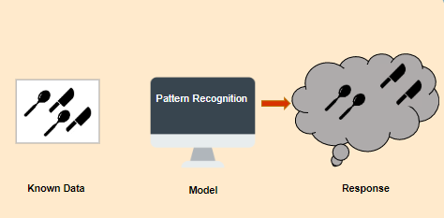
School of Computing Science and Engineering
Course Code : R1UC604C Course Name: Deep Learning
Unsupervised Learning
In Unsupervised Learning, the machine uses unlabelled data and learns on itself without any supervision. The machine tries to find a pattern in the unlabelled data and gives a response.
Unsupervised learning can be further grouped into clustering and association.
Name of the Faculty: Dr. Abdul Aleem Program Name: B.Tech CSE

Slide 28
School of Computing Science and Engineering
Course Code : R1UC604C Course Name: Deep Learning
Clustering
Clustering is the method of dividing the objects into clusters which are similar between them and are dissimilar to the objects belonging to another cluster.
For example, finding out which customers made similar product purchases.
Suppose a telecom company wants to reduce its customer churn rate by providing personalized call and data plans.
The behaviour of the customers are studied and the model segments the customers with similar traits.
Example discussed on next slide.
Name of the Faculty: Dr. Abdul Aleem Program Name: B.Tech CSE

Slide 29
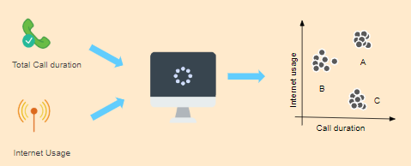
School of Computing Science and Engineering
Course Code : R1UC604C Course Name: Deep Learning
Several strategies are adopted to minimize churn rate and maximize profit through suitable promotions and campaigns.
In the right side of the image, you can see a graph where customers are grouped.
Group A customers use more data and also have high call durations.
Group B customers are heavy Internet users, while Group C customers have high call duration.
So, Group B will be given more data benefit plants, while Group C will be given cheaper called call rate plans and group A will be given the benefit of both.
Name of the Faculty: Dr. Abdul Aleem Program Name: B.Tech CSE

Slide 30
School of Computing Science and Engineering
Course Code : R1UC604C Course Name: Deep Learning
Clustering Algorithms
Distance-based: K-Means
Density-based: DBSCAN
Hierarchical-based: Agglomerative Clustering
…
Name of the Faculty: Dr. Abdul Aleem Program Name: B.Tech CSE

Slide 31
School of Computing Science and Engineering
Course Code : R1UC604C Course Name: Deep Learning
Association Analysis
Association is a rule-based machine learning to discover the probability of the co-occurrence of items in a collection.
For example, finding out which products were purchased together.
Market Basket Example is discussed on next slide.
Name of the Faculty: Dr. Abdul Aleem Program Name: B.Tech CSE

Slide 32
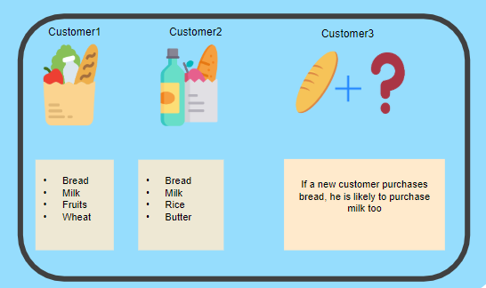
School of Computing Science and Engineering
Course Code : R1UC604C Course Name: Deep Learning
Market Basket Example
Let’s say that a customer goes to a supermarket and buys bread, milk, fruits and wheat.
Another customer comes and buys bread, milk, rice and butter.
Now, when another customer comes, it is highly likely that if he buys bread, he will buy milk too.
Hence, a relationship is established based on customer behaviour and recommendations are made.
Name of the Faculty: Dr. Abdul Aleem Program Name: B.Tech CSE

Slide 33
School of Computing Science and Engineering
Course Code : R1UC604C Course Name: Deep Learning
Association Rule Mining Algorithms
Apriori
FP-Growth
ECLAT
…
Name of the Faculty: Dr. Abdul Aleem Program Name: B.Tech CSE

Slide 34
School of Computing Science and Engineering
Course Code : R1UC604C Course Name: Deep Learning
Real Life Applications of Unsupervised Learning
Market Basket Analysis - It is a machine learning model based on the algorithm that if you buy a certain group of items, you are less or more likely to buy another group of items.
Identifying Accident Prone Areas - Unsupervised machine learning models can be used to identify accident-prone areas and introduce safety measures based on the intensity of those accidents.
Name of the Faculty: Dr. Abdul Aleem Program Name: B.Tech CSE

Slide 35
School of Computing Science and Engineering
Course Code : R1UC604C Course Name: Deep Learning
Supervised Learning | Unsupervised Learning
Supervised learning algorithms are trained using labelled data. | Unsupervised learning algorithms are trained using unlabelled data.
Supervised learning model predicts the output. | Unsupervised learning model finds the hidden patterns in data.
In supervised learning, input data is provided to the model along with the output. | In unsupervised learning, only input data is provided to the model.
The goal of supervised learning is to train the model so that it can predict the output when it is given new data. | The goal of unsupervised learning is to find the hidden patterns and useful insights from the unknown dataset.
Supervised learning needs supervision to train the model. | Unsupervised learning does not need any supervision to train the model.
Supervised learning can be categorized in Classification and Regression problems. | Unsupervised Learning can be classified in Clustering and Associations problems.
Supervised learning can be used for those cases where we know the input as well as corresponding outputs. | Unsupervised learning can be used for those cases where we have only input data and no corresponding output data.
Supervised learning model produces an accurate result. | Unsupervised learning model may give less accurate result as compared to supervised learning.
It includes various algorithms such as Linear Regression, Logistic Regression, Support Vector Machine, Multi-class Classification, Decision tree, Bayesian Logic, etc. | It includes various algorithms such as Clustering, KNN, and Apriori algorithm.
Name of the Faculty: Dr. Abdul Aleem Program Name: B.Tech CSE

Slide 36
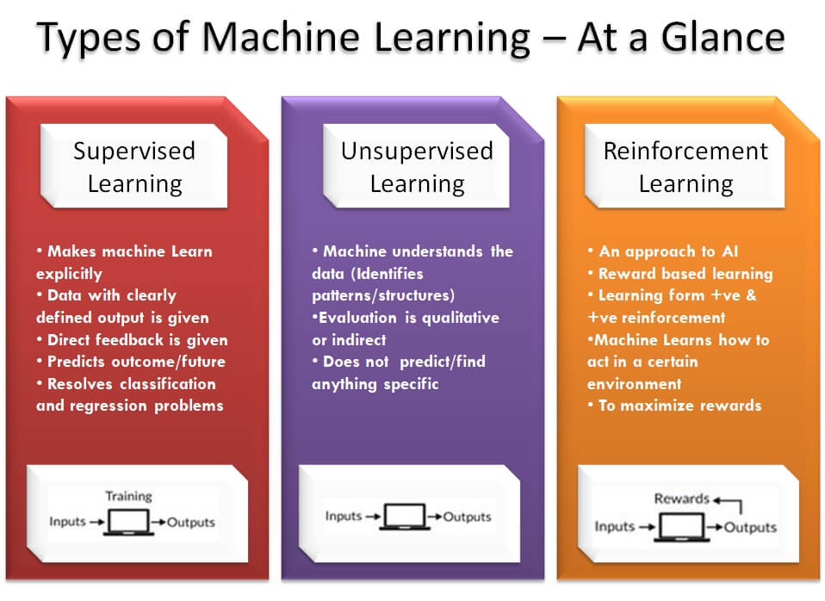
School of Computing Science and Engineering
Course Code : R1UC604C Course Name: Deep Learning
Name of the Faculty: Dr. Abdul Aleem Program Name: B.Tech CSE

Slide 37
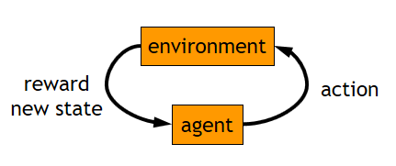
School of Computing Science and Engineering
Course Code : R1UC604C Course Name: Deep Learning
Reinforcement Learning
More general than supervised / unsupervised learning.
Learn from interaction with environment to achieve a goal.
Used when need to make decisions in uncertain environment.
Simple algorithms design features, state representation, rewards.
“Robot in a Room” example discussed on next slide.
Name of the Faculty: Dr. Abdul Aleem Program Name: B.Tech CSE

Slide 38
School of Computing Science and Engineering
Course Code : R1UC604C Course Name: Deep Learning
Robot in a Room
 |  |  | +1
 |  |  | -1
START
Actions: UP, DOWN, LEFT, RIGHT
UP
80% move UP
10% move LEFT
10% move RIGHT
Reward +1 at [4,3], -1 at [4,2]
Reward -0.04 for each step
What’s the strategy to achieve max reward?
What if the actions were deterministic?
Name of the Faculty: Dr. Abdul Aleem Program Name: B.Tech CSE

Slide 39
School of Computing Science and Engineering
Course Code : R1UC604C Course Name: Deep Learning
Is this a Solution?
 |  |  | +1
 |  |  | -1
Only if actions deterministic
Not in this case (actions are stochastic)
Solution/policy
Mapping from each state to an action
Name of the Faculty: Dr. Abdul Aleem Program Name: B.Tech CSE

Slide 40
School of Computing Science and Engineering
Course Code : R1UC604C Course Name: Deep Learning
Optimal Policy
 |  |  | +1
 |  |  | -1
Name of the Faculty: Dr. Abdul Aleem Program Name: B.Tech CSE

Slide 41
School of Computing Science and Engineering
Course Code : R1UC604C Course Name: Deep Learning
Not Always .. We need to Learn
 |  |  | +1
 |  |  | -1
Name of the Faculty: Dr. Abdul Aleem Program Name: B.Tech CSE

Slide 42
School of Computing Science and Engineering
Course Code : R1UC604C Course Name: Deep Learning
Reward for each step: +0.01
 |  |  | +1
 |  |  | -1
Name of the Faculty: Dr. Abdul Aleem Program Name: B.Tech CSE

Slide 43
School of Computing Science and Engineering
Course Code : R1UC604C Course Name: Deep Learning
Markov Decision Process (MDP)
Set of states S, set of actions A, initial state S₀
Transition model P(s,a,s’)
P( [1,1], up, [1,2] ) = 0.8
Reward function r(s)
r( [4,3] ) = +1
Goal: maximize cumulative reward in the long run
Policy: mapping from S to A
π(s) or π(s,a) (deterministic vs. stochastic)
Reinforcement learning
Transitions and rewards usually not available.
How to change the policy based on experience.
How to explore the environment.
Name of the Faculty: Dr. Abdul Aleem Program Name: B.Tech CSE

Slide 44


